Slide 1




THEORY OF COMPUTATION
TOC
CONTEXT-FREE GRAMMAR AND PARSING ALGORITHMS IN COMPILER DESIGN.
16010421073 -
16010421076 -
16010421077 -
KEYUR PATEL
PRANAV PATIL
RUTUJA PATIL

Slide 2


CONTENT
01
COMPILER'S ROLE
02
COMPILER PHASES
03
CONTEXT-FREE GRAMMAR (CFG)
04
PARSING SIGNIFICANCE
05
PRESENTATION FOCUS

Slide 3

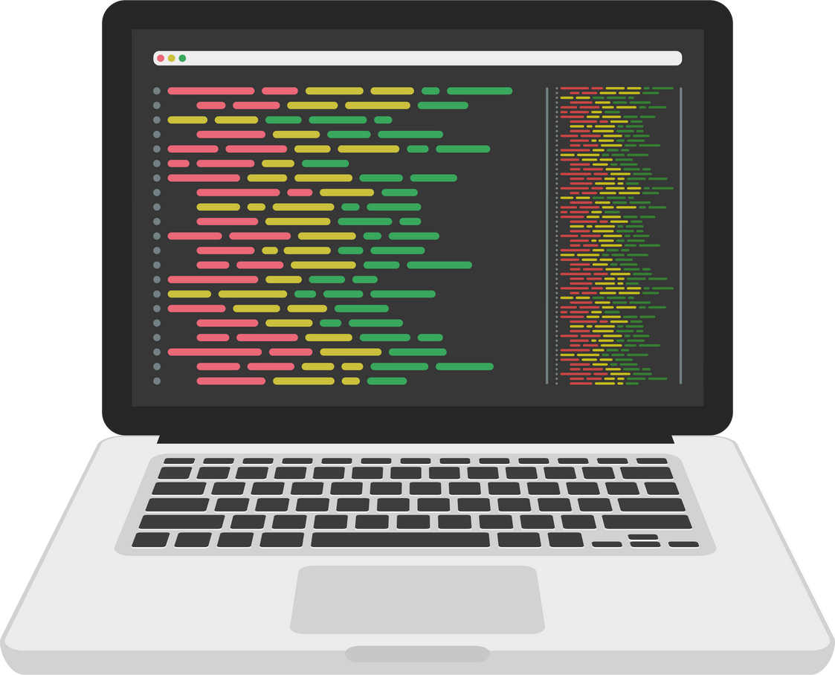


COMPILER
A compiler is a specialized software tool that translates human-readable source code written in a high-level programming language into machine-executable code (usually in the form of binary code or assembly language).
They translate high-level source code into a lower-level representation that can be executed by a computer's hardware.

Slide 4





COMPILER PHASES
Parsing
Intermediate Code Generation
Structurally analyzing source code.
Producing an intermediate representation.
Semantic Analysis
Lexical Analysis
Ensuring semantic correctness.
Code Generation
Scanning and tokenizing source code.
Generating target machine code.

Slide 5

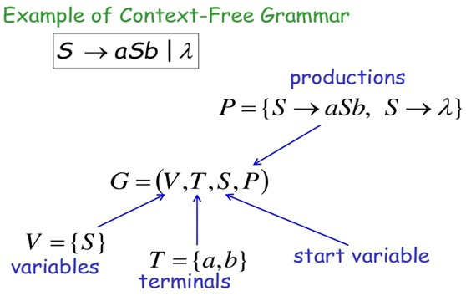
CONTEXT-FREE GRAMMAR
The Context Free Grammar(CFG) is a collection of four-tuple (V,T,P,S)
V is a set of Non-Terminals
S is Start Symbol
Defines a finite set of non-terminal symbols or variables
Represented in Uppercase letters
Derivation should always be with start symbol
T is a set of Terminals
Used to form language constructs
Represented in lowercase letters.
P is Production Rule
Built production rules using non-terminal and terminal symbols

Slide 6
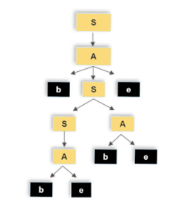
CFG-EXAMPLE
Derivation of bbebee
Parsing Tree
S
S
A
A
SA
A
bSe
be
This production rule states that the non-terminal symbol 'S' can be replaced by the sequence of 'S' followed by 'A'.
S
A
b S e
b S A e
b A A e
b b e A e
b b e b e e
S -> A
A -> bSe
This production rule states that 'S' can also be replaced by 'A' directly.
S -> SA
S -> A
This production rule defines the non-terminal symbol 'A'. It says that 'A' can be replaced by the sequence of 'b', followed by 'S', followed by 'e'.
A -> be
A -> be
This production rule states that 'A' can also be replaced by 'be' directly. This provides an alternative way to generate strings that consist of 'be' when 'A' is encountered.
S,A(uppercase)-Set of Non-Terminals : b,e(lowercase)-Set of Terminals

Slide 7
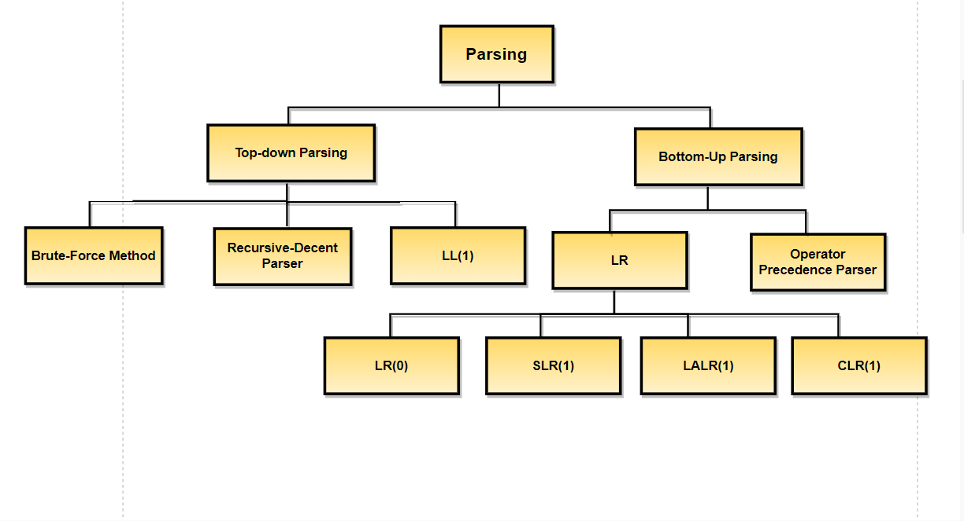
PARSING ALGORITHMS

Slide 8
LR(0) ALGORITHM
The LR(0) algorithm is used to determine whether a given input string can be generated by a given context-free grammar and, if so, to construct a parse tree for the input string. It works by building a finite automaton that represents the possible states of a parser as it processes the input string. This automaton is used to construct a parsing table that guides the parser through the input string.
Various steps involved in the LR (0) Parsing:
Augment Grammer:
It will be generated if we add one more production in the given grammer G. It helps the parser to identify when to stop the parsing and announce the acceptance of the input.
For the given input string write a context free grammar.
Check the ambiguity of the grammar.
Add Augment production in the given grammar.
Create Canonical collection of LR (0) items.
Draw a data flow diagram (DFA).
Construct a LR (1) parsing table.
Conflict Resolution: The LR(0) algorithm may encounter conflicts, such as shift-reduce or reduce-reduce conflicts, in the parsing table. Conflict resolution rules are used to handle these situations.
If the given Grammer (G)
S -> AA
A-> aA | b
Augment Grammer (G’) is represented by-
S’-> S
S -> AA
A-> aA | b

Slide 9
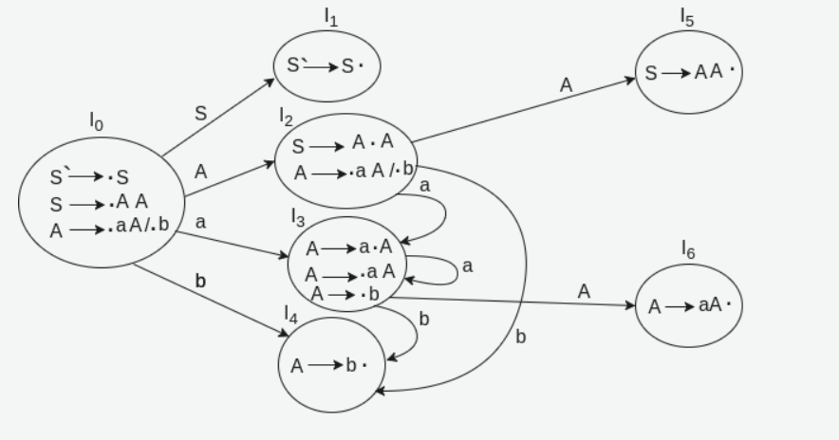
CANONICAL COLLECTION OF LR(0) ITEMS
LR(0) items is useful to indicate that how much of the input has been scanned up to a given point in the process of parsing. Add Augment Production and insert '•' symbol at the first position for every production in G.
Given grammar: After Adding:
S → AA S` → •S A → •aA
A → aA | b S → •AA A → •b
IO State
Add all productions starting with S in to I0 State because "•" is followed by the non-terminal. So, the I0 State becomes
I0 = S` → •S
S → •AA
Add all productions starting with "A" in modified I0 State because "•" is followed by the non-terminal. So, the I0 State becomes.
I0= S` → •S
S → •AA
A → •aA
A → •b
I1= Go to (I0, S) = closure (S` → S•) = S` → S•
Here, the Production is reduced so close the State.
I1= S` → S•
I2= Go to (I0, A) = closure (S → A•A)
Add all productions starting with A in to I2 State because "•" is followed by the non-terminal. So, the I2 State becomes
I2 =S→A•A
A → •aA
A → •b
Go to (I2,a) = Closure (A → a•A) = (same as I3)
Go to (I2, b) = Closure (A → b•) = (same as I4)
I3= Go to (I0,a) = Closure (A → a•A)
Add productions starting with A in I3.
A → a•A
A → •aA
A → •b
Go to (I3, a) = Closure (A → a•A) = (same as I3)
Go to (I3, b) = Closure (A → b•) = (same as I4)
I4= Go to (I0, b) = closure (A → b•) = A → b•
I5= Go to (I2, A) = Closure (S → AA•) = SA → A•
I6= Go to (I3, A) = Closure (A → aA•) = A → aA•
The DFA contains the 7 states I0 to I6.t

Slide 10
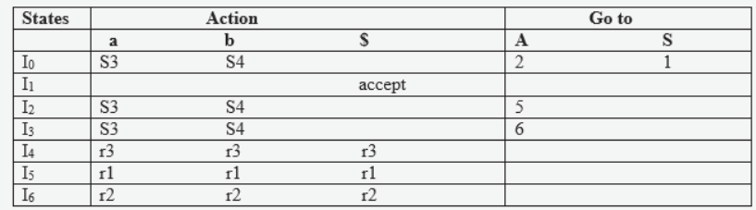
LR(0) TABLE
If a state is going to some other state on a terminal then it correspond to a shift move.
If a state is going to some other state on a variable then it correspond to go to move.
If a state contain the final item in the particular row then write the reduce node completely.
Productions are numbered as follows:
S → AA ... (1)
A → aA ... (2)
.A → b ... (3)
I1 contains the final item which drives(S` → S•), so action {I1, $} = Accept.
I4 contains the final item which drives A → b• and that production corresponds to the production number 3 so write it as r3 in the entire row.
I5 contains the final item which drives S → AA• and that production corresponds to the production number 1 so write it as r1 in the entire row.
I6 contains the final item which drives A → aA• and that production corresponds to the production number 2 so write it as r2 in the entire row.
The DFA constructed with the LR(0) items:t

Slide 11

BRUTE-FORCE(BACKTRACKING) PARSER
CUSTOMERS
Whenever a non-terminal is expanding first time, then go with the first alternative and compare with the i/p string.
If does not matches, go for the second alternative and compare with i/p string, if does not matches go with the 3rd alternative and continue with each and every alternative.
If the matching occurs for at least one alternative, then the parsing is successful, otherwise parsing fail.
A -> b
A -> b
B -> dc
B -> ddc
S
S
S
S
Context-Free Grammer
S -> aAd | aB
A -> b | c
B -> dc | ddc
a
A
d
a
A
d
a
B
a
B
b
c
d
c
d
d
c
W’ = “abd”
W = “addc”
W’ = “acd”
W = “addc”
W’ = “adc”
W = “addc”
W’ = “addc”
W = “addc”
Input String
W = “addc”
Match is Unsuccessful
Match is Unuccessful
Match is Successful
Match is Unsuccessful
Backtracking
Error Handling
If a parsing function reaches a point where it cannot proceed with any of the available production rules, it backtracks to the previous choice point.
This means it undoes any partial parsing and tries a different alternative if available.
If the parser cannot find a valid parse for the input string, it raises a parsing error indicating that the input does not conform to the grammar.

Slide 12
CHALLENGES
Recursive descent parsers, which are based on CFGs, can suffer from backtracking when parsing certain inputs. Backtracking can lead to inefficiency in parsing and can be problematic for error reporting.
CFGs are not well-suited for describing error recovery strategies in parsing. Handling syntax errors and providing meaningful error messages to the programmer can be challenging.
One of the most significant challenges with CFGs is that they can describe ambiguous grammars. An ambiguous grammar is one in which a single string can have multiple valid parse trees or interpretations
ERROR HANDLING
BACKTRACKING
AMBIGUITY

Slide 13

SOME OTHER APPLICATIONS
Natural Language Processing (NLP): Parsing is essential in NLP tasks such as part-of-speech tagging, syntactic parsing, and named entity recognition. It helps understand the grammatical structure of sentences and extract meaningful information from text.
Network Protocols: Parsing algorithms are used in network protocols to decode and encode data packets. This is crucial for communication between devices and systems in computer networks.
Data Validation and Transformation: In data integration and ETL (Extract, Transform, Load) processes, parsing algorithms validate and transform data from one format to another, ensuring data quality and compatibility.

Slide 14

REFERENCES
https://www.geeksforgeeks.org/problem-on-lr0-parser/t
https://www.youtube.com/watch?v=ZjQst1xnCuI&ab_channel=Education4u
https://www.youtube.com/watch?v=PLu8tgUus1k&ab_channel=SuccessGATEway
https://www.youtube.com/watch?v=5_tfVe7ED3g&ab_channel=NesoAcademy

Slide 15


THANK YOU

